Slide 1


One Stop Centre
Increase ease of navigation for information-heavy websites
Chiew Jun Hao (1001046) | Gao Xiongyi (1000894) | Tan Yi Hui Valerie (1001191) | Wang Yujia (1000911) | Zhang Zhexian (1001214)

Slide 2
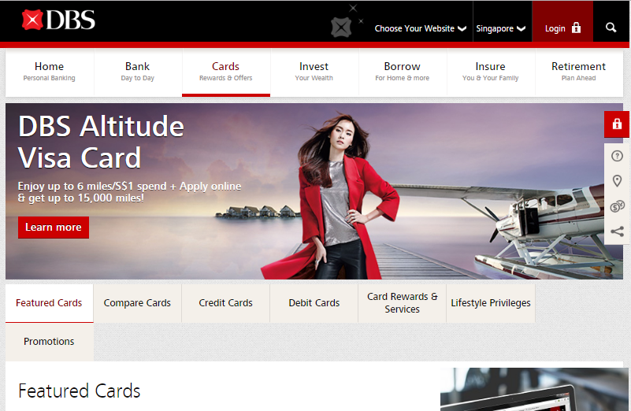
Background
DBS Bank Card Main Page
Notes:
DBS: http://www.dbs.com.sg/personal/cards/default.page
UOB: http://www.uob.com.sg/personal/cards/index.html
OCBC: https://www.ocbc.com/personal-banking/cards/index.html

Slide 3
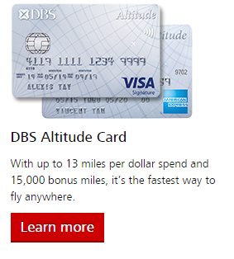
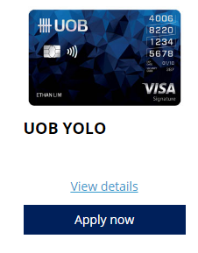
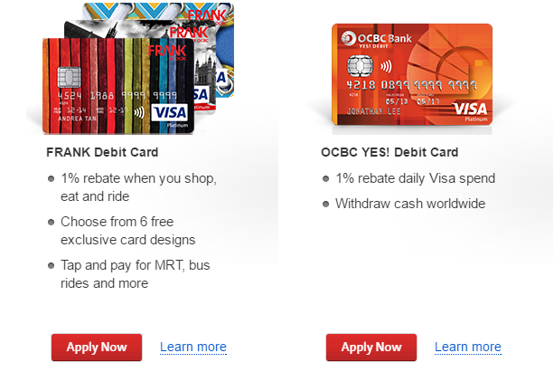
Background
DBS Card
UOB Card
OCBC Cards
Notes:
DBS: http://www.dbs.com.sg/personal/cards/default.page
UOB: http://www.uob.com.sg/personal/cards/index.html
OCBC: https://www.ocbc.com/personal-banking/cards/index.html

Slide 4
Background
Word-based syntactic matching schemes work well for tasks such as homepage finding or fact finding, but they are less effective in supporting exploratory search tasks such as learning and investigation.
- Wu, M., et al. (2010). Presenting Query Aspects to Support Exploratory Search.

Slide 5
Objective Statement

Slide 6
Problem Statement
Customers who lack domain knowledge often find it confusing to get the services/products they want, because information is overloaded, cluttered, and not properly organized.
For example, many customers are having difficulties finding the bank card that suits them best. This is because there are too many terminologies that are unknown to new users- such as credit, debit, or brand-specific terms such as ‘Frank card’, ‘Everyday card’, etc.
Notes:
Revolutionize bank application whatever.. experience by via guidance and streamlining
use the process by designing a guided application scheme using streamlining techniques

Slide 7
Increase the ease of navigation for information-heavy websites

Slide 8
Objective Statement
To design a guided and streamlined application scheme, targeted at information-heavy websites for users to select products/services followed by submit the application, to maximize the learnability, ease of navigation and satisfaction of the users.
Notes:
Revolutionize bank application whatever.. experience by via guidance and streamlining
use the process by designing a guided application scheme using streamlining techniques

Slide 9
User Analysis & Impact

Slide 10


Target User Analysis
Computer Literate
Expert User
Lack of domain knowledge
or experience
Professional
Confused about terminologies
Seek for specific product/service
Need recommendation
and guidance
Hindered by poor
navigation system
Notes:
Specify the application
Without experience and domain knowledge
Seek for a specific product/service
Specific target user for the example site / field we use

Slide 11




Impact
Streamlined process, easy and clear navigation
Don’t require too much background knowledge
Prevent information overflow
Reduce frustration
Notes:
How our solutions may be beneficial beyond our scope

Slide 12
Preliminary Literature Review

Slide 13


Existing Problem
Figure 1. Application for DBS products
Figure 2. Application for OCBC products

Slide 14
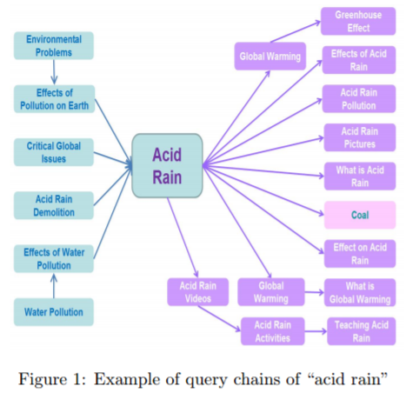
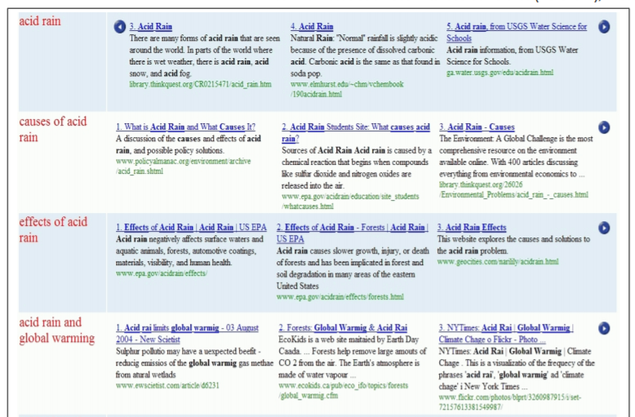
Exploratory Search
Figure 3. Sample query chains for ‘Acid Rain’ Search
Figure 4. Tabular Aspect Interface for Acid Rain
Wu, M., et al. (2010). Presenting Query Aspects to Support Exploratory Search.
Notes:
Word-based syntactic matching schemes work well for tasks such as homepage finding or fact finding, but they are less effective in supporting exploratory search tasks such as learning and investigation. One way to overcome this limitation of syntactic matching is to capture the search journeys of other users with semantically related queries, and use them as a roadmap to guide exploratory search.

Slide 15
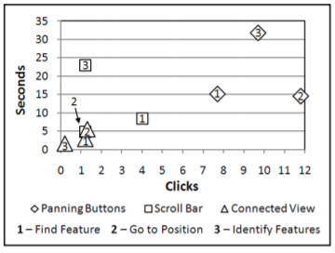
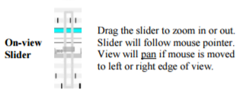
Navigation Tools for Genetic Sequence
Widget to find specific genetic sequence that scientist needs
Figure 5. On-view slider is a 2-degree of freedom slider that allows user to pan and zoom
Figure 6. A graph that show user perform under different navigation methods
Abell R, Churcher, McKinnon (2010). Usability of Navigation Tool for Browsing Genetic Sequences.

Slide 16
Re-Design Samples

Slide 17
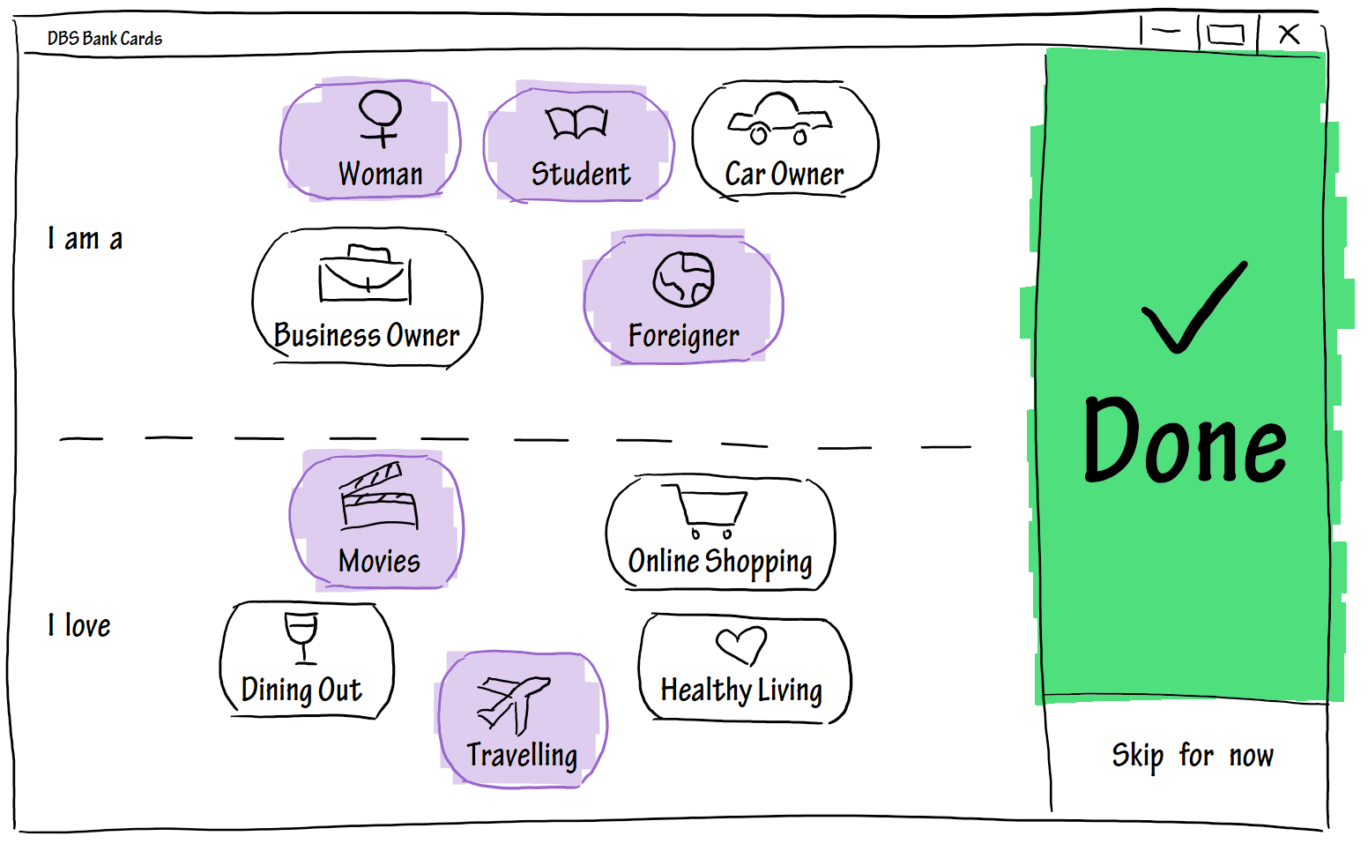
Notes:
So prettty! <3

Slide 18
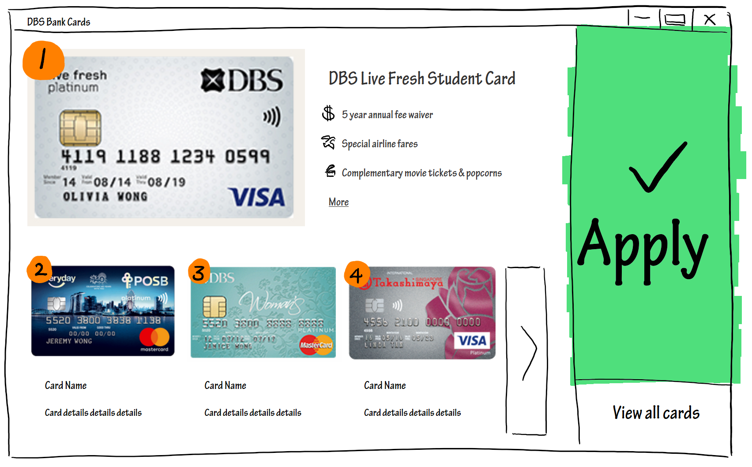

Slide 19
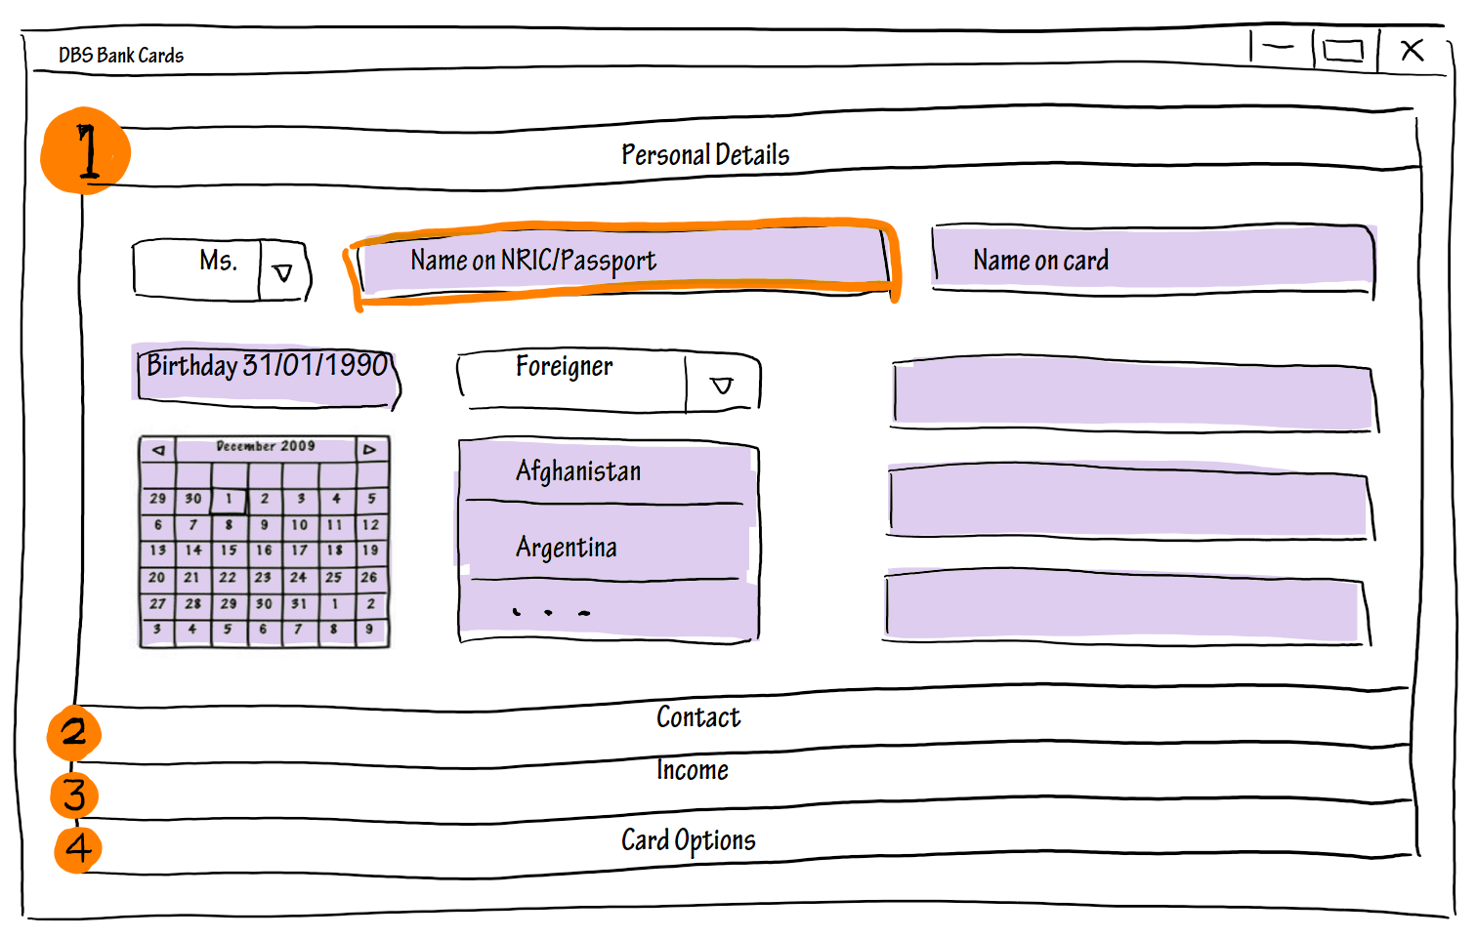

Slide 20
Navigation Flow
Filtering
Recommendation
Application

Slide 21

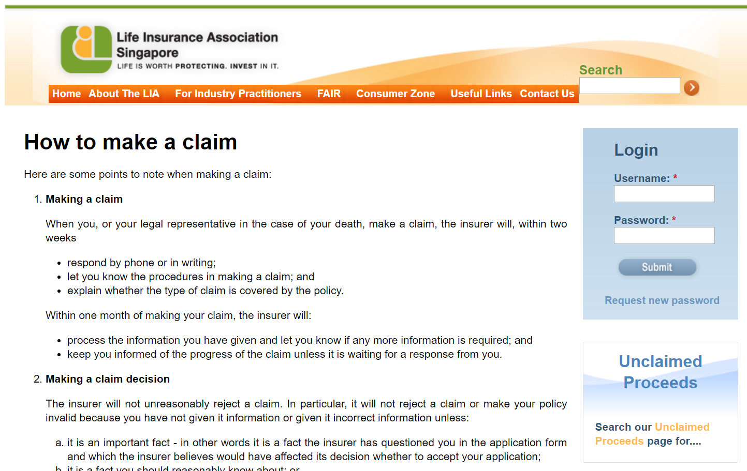
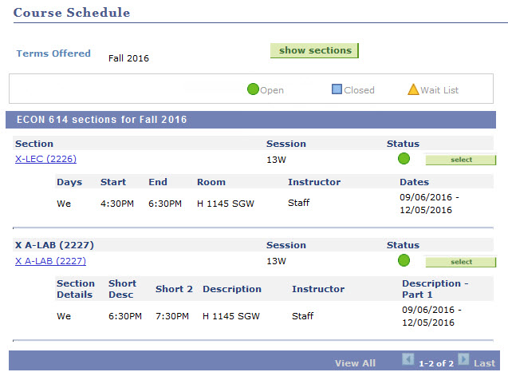
Further Applications
VISA application
Insurance Claim
Course Enrolment

Slide 22
Planning

Slide 23
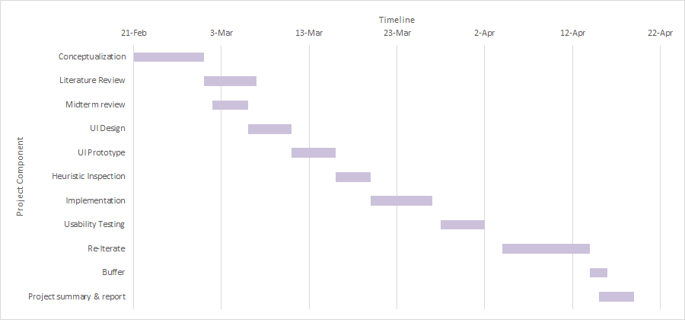
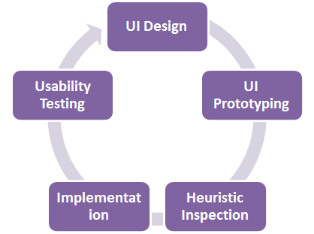
Gantt Chart Schedule

Slide 24

Work Allocation
VALERIE
Planning
Usability Tester
YUJIA
QC- Quality Control
Project Manager
Programmer
ZHE XIAN
Usability Tester
Prototype Designer
XIONG YI
Programmer
Prototype Designer
JUN HAO
Programmer
Literature Reviewer

Slide 25
Implementation
Mockup - Pen and paper, stylus, GUIToolkit
Prototyping - Invision / FluidUI
Implementation - Web development (HTML, CSS, JavaScript, Python)

Slide 26


Usability Evaluation Aspects
Heuristic Inspection Method
Attempt various application processes for ourselves
Track click distances, time taken & overall ease of navigation
Questionnaire
Existing Designs vs. Improved Design ⇒ Relative Improvement Score

Slide 27
Usability Evaluation – Test Method
Observation Technique |  | Contextual interviews: watch how user navigates in their natural environment, direct, silent observation at the side
Evaluation Method |  | First-click Testing Scenarios
Test Metrics | Measurable Outcomes | Successful Task Completion Critical Errors Non-critical Errors Error-free Rate Time on Task
 | Subjective measures | Likes, Dislikes and Recommendations

Slide 28
Usability Evaluation Metrics – Usability Goals
 | Priority Level | Criteria | Measurement Aspect | Measurement Technique
Usability Goals | 1 | Learnability | Time to master a task ( number of retries required to achieve zero error rate) | Direct Observation
 | 2 | Error Rate | Number of errors | Direct Observation
 | 3 | Efficiency | Time to complete task | Direct Observation
 | 4 | Memorability | Percentage of procedure remembered by user | Questionnaire
 | 5 | Satisfaction | Opinion rating | Questionnaire

Slide 29
Usability Evaluation Metrics – UX Goals
 | Priority Level | Criteria | Measurement Aspect | Measurement Technique
UX goals | 1 | Satisfying | Opinion rating – intuitive, easy to use | Questionnaire
 |  |  | Facial expression – frustrated, peaceful, happy etc | Webcam / Observation
 | 2 | Enjoying | Ease of navigation, (low) level of frustration | Questionnaire
 | 3 | Motivating | Time of self-exploration | Direct Observation
 | 4 | Aesthetic | Opinion rating – layout, colours & fonts, etc | Questionnaire

Slide 30
Thank you! Q&A
Chiew Jun Hao (1001046) | Gao Xiongyi (1000894) | Tan Yi Hui Valerie (1001191) | Wang Yujia (1000911) | Zhang Zhexian (1001214)

Slide 31
Reference
[1] Nichols, Mahmud, O’Donovan (2016). Proceedings of the 21st International Conference on Intelligent User Interfaces. IUI'16 21st International Conference on Intelligent User Interfaces. Retrieved from http://dl.acm.org/citation.cfm?id=2856767
[2] Rutherford, Abell, Churcher, McKinnon (2010). Usability of Navigation Tool for Browsing Genetic Sequences. AUIC '10 Proceedings of the Eleventh Australasian Conference on User Interface , Volume 106 Pages 33-41. Retrieved from http://dl.acm.org/citation.cfm?id=1862287
[3] Wu, M., Turpin, A. et al. (2010). Presenting Query Aspects to Support Exploratory Search. 11th Australasian User Interface Conference (AUIC2010), Volume 106. Retrieved from http://crpit.com/confpapers/CRPITV106Wu.pdf

